Slide 1

7023T
Advanced Database Systems
Session 06
Enrichment Activity
Bussiness Intelligence Application Development

Slide 2
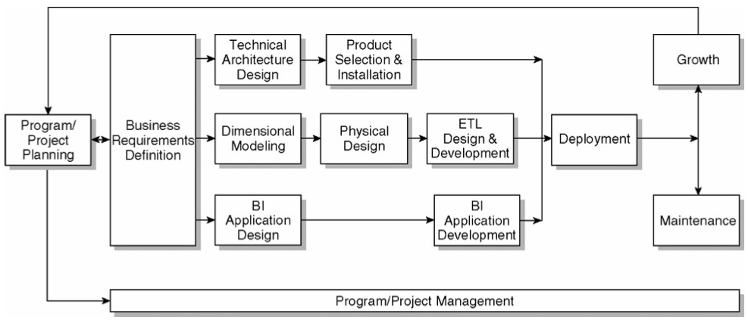
The Kimball Lifecycle Diagram

Slide 3
BI Application Position
BI applications are a critical part of the overall DW/BI system
Significant set of resources dedicated to the production and maintenance of all flavors of BI applications

Slide 4
BI Developer Organization
Central group of BI developers as part of the overall DW/BI team
This central group is part of the core project team and is involved in the requirements definition process and dimensional model design
Additional BI developers located in the business as they are usually the best representatives of the business users

Slide 5
BI Application Development Lifecycle
BI Application Specification
BI Application Development
BI Application Maintenance

Slide 6
BI Application Specification
The specification of BI applications breaks down into five major activities:
Create Application Standards and Templates
Determine the Initial Application Set
Develop Detailed Application Specifications
Design the Navigation Framework and Portal
Review and Validate the Applications and Model

Slide 7
Create Application Standards and Templates
Determine Naming Standards
Develop standards for the data access environment which cover areas like naming, formatting, and common fields
Create the Application Templates
creating a standard template for the physical layout of your BI applications
Create Dashboard and Analytic Application Templates
Typical dashboard or analytic application incorporates several different elements, including reports, charts, and special dashboard controls such as alert indicators

Slide 8
Application Templates: Example
Notes:
You will also need to create the following information for each report:
􏰀 User variables and other user interactions, like drilldown paths and links.
􏰀 Report metadata, including description, calculations, derivations, author, and
date created.
􏰀 Security requirements, including a list or description of the security groups
who can see the report.
􏰀 Execution cycle, if the report is to run automatically on a periodic basis.
􏰀 Execution trigger event, if the report is to be executed in response to a system
event like the completion of the nightly data load.
􏰀 Delivery mechanisms, such as email, web site, file directory, or printer.
􏰀 Delivery list, which is generally the name of an email distribution list.
􏰀 Standard output format, such as text, html, PDF, Excel, or Word.
􏰀 Page orientation, size, and margin settings.

Slide 9
Dashboard Template: Example

Slide 10
Determine the Initial Application Set
Develop the target list of reports, a small set of high value reports that provide a range of report types
The process of generating the target list involves three tasks:
Identify Report Candidates
Consolidate the Candidate List
Prioritize the Report List
Notes:
Consolidate the Candidate List
Identify those reports on the list that are essentially different versions of the same report
Categorize the items — which data elements does each report contain in each section?
Prioritize the Report List
Some of the factors to consider include business value, data availability, degree of development difficulty, scope of use, and user importanc

Slide 11
Identify Report Candidates
The project's consolidated requirement findings and supporting notes, described are the ideal places to begin drawing up a list of potential reports
A spreadsheet could be used to make a list of individual report requests, including: name, type of report, row data elements, column data elements, measures, and additional attributes that might help in the consolidation process

Slide 12
Identify Report Candidates: Example

Slide 13
Develop Detailed Application Specifications
Split the target list of reports up among the available business and technical folks who are capable of developing reports
Have each person work through the following for their subset of the target list, and bring the results back for group review and discussion
Each report/application should have the following set of documentation: mock up, user interactions, datasets, algorithms, advanced calculations, and business rules, interactions with other reports/systems
Specify application content

Slide 14
Application Definition: Example

Slide 15
Report Mock up: Example

Slide 16
Design the Navigation Framework and Portal
Devise a method for grouping and organizing these BI application objects
The organization's business processes to be a good starting point for structuring this navigation framework and associated BI portal

Slide 17
Application Navigation Framework: Example

Slide 18
Review and Validate the Applications and Model
Verify the attributes, constraints, hierarchies, measures, and appropriate grain of each report specification exist in the model
Compare each report to the model and think about how we would write the SQL or OLAP queries for the report
If we have resources and data available, and we have selected and installed your front end BI tool, we can do some prototyping

Slide 19
BI Application Development Lifecycle
BI Application Specification
BI Application Development
BI Application Maintenance

Slide 20
BI Application Development
BI application development process follows a standard software development flow: prepare, build, test, and then deploy:
Build the Applications
Test and Verify the Applications and Data
Complete the Documentation
Plan for Deployment
Prepare for Application Development
Notes:
Complete the Documentation
business level documentation that should already be securely stored in the metadata catalog, it is vital to document the application template infrastructure information as well
Plan for Deployment
If your BI tool doesn't offer code management capabilities like version tracking and roll back, figure out how to include the BI applications in your development environment code management system

Slide 21
Prepare for Application Development
Install and Test the BI Tools
Some of BI tools have many components, each of which operates as a separate service such as web server. Once the basic components are in place, we usually need to define metadata to access the database
Validate Your BI Application Interface Strategy
We may decide to use a web based portal tool, the navigation components of BI tool, dashboard tools, or code-based interfaces
Set Up User Security
Set Up the Report Process Metadata System
data about the use and performance of the BI applications

Slide 22
Build the Application (1)
Follow the Core Process
Generally involves three major activities: 1) defining the user interactions, 2) creating the queries, and 3) formatting the results
Design and Develop Analytic Applications
Develop the core of your application in a more standard programming environment, typically a web-based tool, like ASP.NET or JSP
Design and Develop Operational BI Applications
operational BI usually pushes the DW/BI system in terms of data latency. These applications often require data that is closer to real time
Include Data Mining Models

Slide 23
Data mining model development and implementation process

Slide 24
Build the Application (2)
Validate the Data and Data Model
Use the BI applications to validate the data model and the data itself
Create the Navigational BI Portal
Provide a navigation framework or BI portal that allows people to find the information they need
Set Up Report Scheduling
Most BI tool vendors provide a reporting service that allows you to schedule standard reports to run with predefined parameters. These reports may run at a regularly scheduled time

Slide 25
Sample second level portal page for the sales business process

Slide 26
Test and Verify the Applications and Data
Check logic of each report
Create a simple query and copy the data for a report into a spreadsheet and recreate the calculations by hand. Verify that your percentages and variances are based on the correct numbers
Check the data, some of the most common issues:
Meaningless descriptions
Duplicate dimension information
Incorrect dimensional relationships
Data not balancing
Performance tuning

Slide 27
BI Application Development Lifecycle
BI Application Specification
BI Application Development
BI Application Maintenance

Slide 28
Business Intelligence Application Maintenance
BI applications are not a one-time project. The initial set, and all subsequent additions, will need to be maintained and enhanced
Application maintenance includes following kinds of activities:
Adding new BI applications built by both business users and the DW/BI team
Updating BI applications to include new data sources or changes to existing sources.
Monitoring BI application performance.
Removing unused BI applications based on the monitoring system

